Slide 1
MISQ Paper Revision Plan
Dylan Junluo CHEN, Ben LIU, Xin LI
Notes:
Thank you for your time today. We really appreciate the opportunity to discuss our revision plan with you. Today, we want to walk you through what we changed, why we changed it, and how our new theory connects to the empirical results. Let’s go.

Slide 2
Outline
Summary of our paper (page 2~4)
Review panel’s major concern (page 5)
SE’s suggestion (page 6)
Our plan
Notes:
We have four parts. First, a quick recap of our paper — just to make sure we're on the same page. Then, the review panel's main concern. After that, your suggestion — and which direction we picked. Finally, the core of today: our new theoretical framework and how it maps onto the results.

Slide 3


Background
Online Q&A Communities
Supply
Internal GenAI
Supply
Supply
Questions
Answers
Questioners
Answerers
Our Research Question:
How does internal GenAI affect human answerers (supply) and viewers (recognition) in online Q&A communities?
External GenAI
(e.g., ChatGPT)
Notes:
So, a quick recap. ChatGPT challenges online Q&A communities. Questioners no longer post questions in communities, because they can directly ask ChatGPT. Many existing studies have already looked at the impact of ChatGPT on online Q&A communities.
But here, we look at a totally different phenomenon - internal generative AI. Again, internal GenAI means AI bots developed by a platform and used only within this particular platform.
Our research question is straightforward. We want to look at the impact of the internal GenAI. (We care about two outcomes. One is supply — do fewer humans show up to answer? The other is recognition — do viewers appreciate human answers less?)

Slide 4
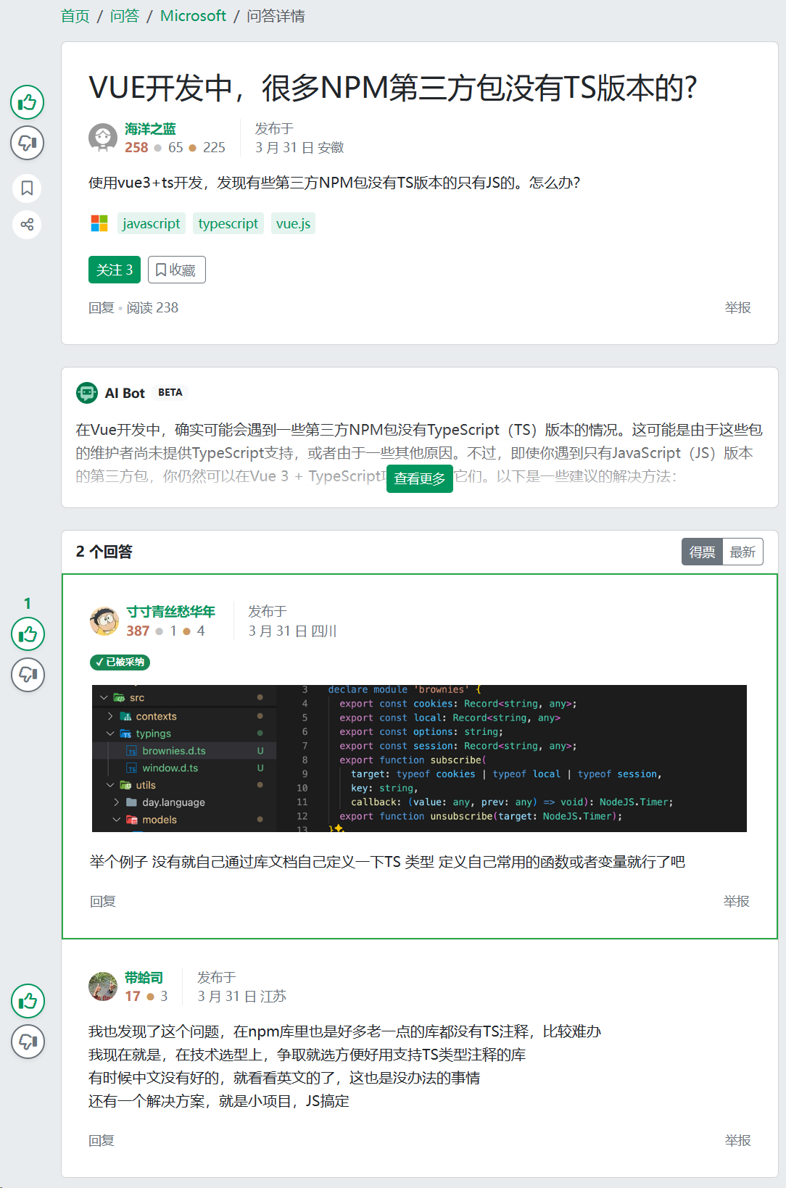
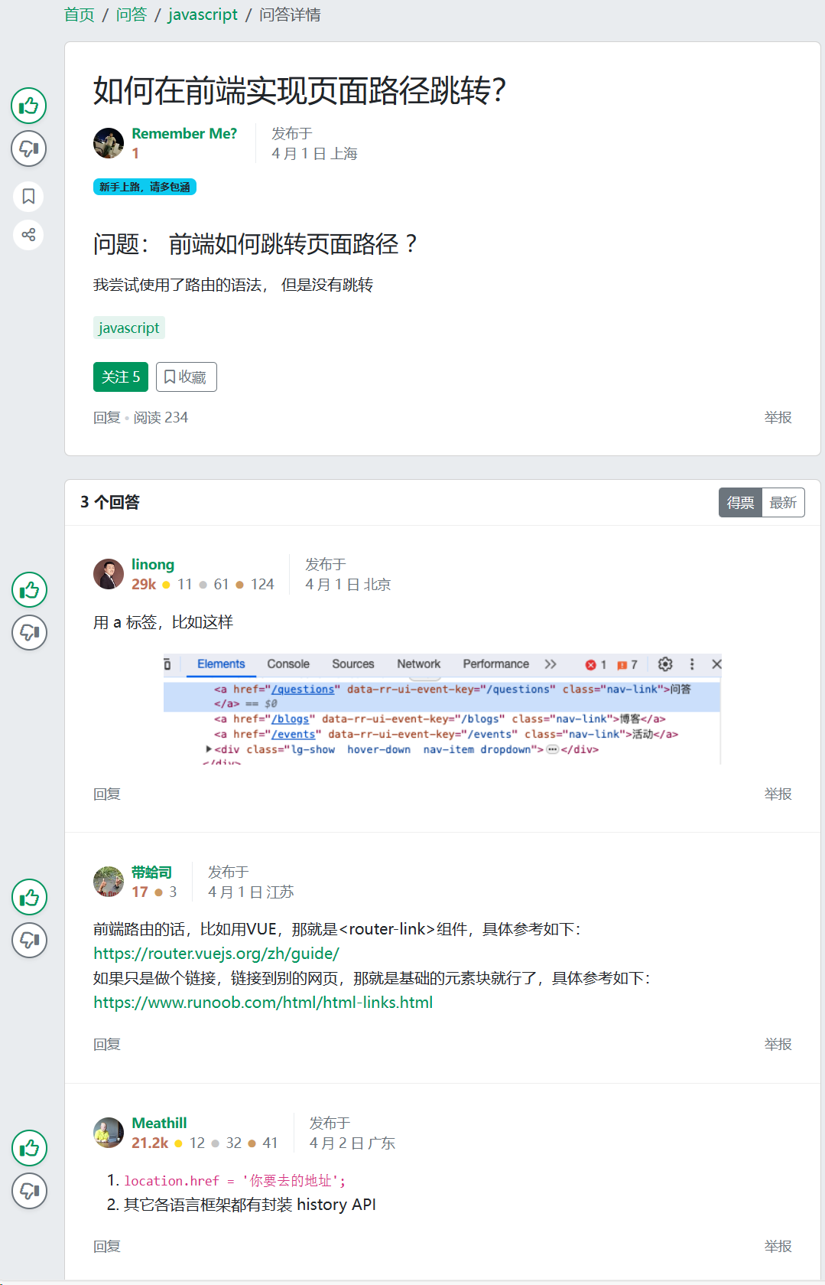
A randomized field experiment on SegmentFault
AI group (treatment group)
no AI group (control group)
Notes:
we use a randomized experiment conducted by the SegmentFault. SegmentFault is a leading Chinese online Q&A community. The platform randomly assign questions to treatment group or control group. Treated questions receive AI answers very quickly. Control questions receive no AI answers.
Here is an illusration. Blue box indicates the questions in both treatment and control. For treatment question, platform provides AI answer very quickly. In contrast, control group receive no AI answers. Green boxes are human answes. Both treatment group and control group receive human answers.

Slide 5
Original framing (not drawn in the paper)
mechanisms
Source Effect
Answerer Participation
Content Effect
(-)
Position Effect
Has AI Answer
Quality Degradation
(-)
Viewer Recognition
Attention Diversion
Elevated Expectations
Notes:
Now, let me show you our original framing. In the first submission, we had two main effects — AI reduces participation, AI reduces viewer recognition — and then we proposed mechanisms for each.
For participation, we had three mechanisms: source effect, content effect, and position effect. For recognition, we tested quality degradation, attention diversion, and elevated expectations.
The structure was: here's the effect, here are three possible explanations, let's test them one by one. This is what the reviewers pushed back on.

Slide 6
Review panel’s major concerns
Need an overarching theoretical framework
Need specific justifications on each mechanism (source, content, and position)
Need a stronger connection between theory and empirical findings
Need deeper explanation: why our results are different from Su et al. (2023)
Su, Y., Zhang, K., Wang, Q., & Qiu, L. (2023). Generative AI and Human Knowledge Sharing: Evidence from a Natural Experiment. SSRN Scholarly Paper.
Notes:
The core concern was theory. The panel said we lack an overarching framework. Let me be specific about what they meant.
First — no unified logic tying everything together. We had pieces, but no spine.
Second — our three mechanisms for participation — source, content, position — felt ad hoc. Reviewer 2 asked: are these theoretically justified? Reviewer 3 said: they're introduced in isolation, not derived from one coherent logic.
Third — the relationship between theory and results was unclear. The reviewers couldn't see how the hypotheses follow from a single set of assumptions.
And finally, they asked: how is this different from Su et al. 2023? That paper also studies AI and human contribution. We need a clear theoretical boundary.

Slide 7
SE’s suggestions
Three possible routes
A. Incentive: participation incentives in online knowledge communities.
B. Authority: authority and credibility signals in human–AI interaction
C. Competition: competition and complementarity between AI and human
√
Notes:
You gave us three possible directions. One was participation incentives. Two was authority and credibility signals. Three was competition and complementarity between AI and human knowledge.
You specifically noted that a competition-complementarity framing could explain both when AI discourages humans and when it stimulates them. That's the direction we picked.
We chose it for a practical reason: our data actually shows both effects. AI deters contributions under some conditions and elevates quality under others. A competition lens captures that duality naturally.

Slide 8
Simplify the model
Source Effect
Reasons:
Reviewer concerns on our test (R1, R2, R3)
Difficult to understand (R2)
Answerer Participation
Content Effect
(-)
Position Effect
Has AI Answer
Quality Degradation
Reason:
Focus on the behavioral processes of answerers (SE)
(-)
Viewer Recognition
Attention Diversion
Elevated Expectations
Notes:
On the top right, you see a red cross on the position effect mechanisms for participation. All three reviewers said this is hard to identify cleanly. Reviewer 2 specifically said they couldn't follow the logic. So we don't keep them as separate, isolated mechanisms. Instead, we rebuild from scratch with one unified logic.
On the bottom, the entire viewer recognition part is crossed out. This is a bigger change. The SE's letter told us to move from documenting empirical regularities to explaining behavioral processes. Viewer recognition — measured by upvotes — is an outcome, but it doesn't tell us much about why humans behave differently. So we shift our focus entirely to the supply side: what answerers do and how well they do it.
This gives us a tighter paper. Two DVs — participation and answer quality — both on the answerer side, both explained by one theory.
Now let me show you what replaces all of this.

Slide 9
New framework
Previous
Core DV
Answerer Participation
Previous Source Effect
Has AI Answer
New DV
Answer Quality
AI Answer Length
AI Answer Quality
Previous Content Effect
Previous Content Effect
Fast Processing
Slow Processing
Notes:
Here is our new framework. Let me walk you through it.
We now have two dependent variables. The first is answerer participation — the quantity of human answers. The second is answer quality — measured by how good the first human answer is.
The treatment is still "Has AI Answer." But now, we explicitly model two properties of the AI answer: its length and its quality. These are not just control variables. They play different theoretical roles.
The key insight is at the bottom of this diagram. Length is processed fast. Quality is processed slow. This distinction drives the entire theory.
Let me map old to new so you can see exactly what changed.
Our old "source effect" — AI as a label — maps onto the direct arrow from "Has AI Answer" to participation. That's still there.
Our old "content effect" — AI answer characteristics — now splits into two: length and quality, each with a distinct theoretical role.
What‘s new? Answer quality as a dependent variable. In the old version, this was buried in our mechanism section. Now it’s a core DV. The reviewers questioned our old quality measure, and we use a new measure to address that directly.

Slide 10
AI’s two roles in competition
Answerer Participation
+
AI label signals weak competition
Has AI Answer
-
Answer Quality
-
-
AI content generate concrete competition
AI Answer Length
AI Answer Quality
Fast Processing
Slow Processing
Notes:
Here is the theoretical core. AI plays two roles simultaneously.
Role one: AI is a competitor that humans perceive as weak. When answerers see the AI label, their first reaction is — "I can beat this." They don't need to read the content. The label alone triggers a competitive response. This is about identity. These are experts. SegmentFault is their territory.
Role two: The AI's actual content creates real competitive pressure. Once answerers engage with what the AI wrote — its length, its quality — that's when the concrete competitive dynamics kick in. The content can either reinforce or override the initial "weak competitor" perception.
These two roles operate on different timescales, which brings us to the next piece.

Slide 11
Fast and slow: two different decisions
Answerer Participation
+
Has AI Answer
Based on Kahneman (2011)
Answerers make two decisions
1) Fast: whether to participate
2) Slow: how to contribute
-
Answer Quality
-
-
AI Answer Length
AI Answer Quality
Fast Processing
Slow Processing
Kahneman, D. (2011). Thinking, fast and slow. Farrar, Straus and Giroux.
Notes:
We ground this in dual-process theory — Kahneman's System 1 and System 2.
Answerers face two decisions. First: should I participate? This is a fast decision. You glance at the page, you see an AI answer, you decide in seconds whether to invest your time. What drives this? Fast signals. Length is a fast signal. You don't need to read carefully — you can see at a glance how much space the answer occupies.
Second: how much effort do I put in? This is a slow decision. You've already committed to answering. Now you need to figure out how good the AI answer actually is. That requires reading, evaluating, comparing. Quality is a slow signal.
This is why length affects participation but not quality. And quality affects quality but not participation. They operate through different cognitive channels.

Slide 12
Theoretical Development: Competition with a "Weaker" Competitor
Humans first view AI as a weak competitor (before seeing content),
Then, AI content generates real competitive dynamics
DV | Contribution (Fast) | Answer Quality (Slow)
AI Label | H1: ↑ (Competitive Arousal Theory) | H3: ↓ (Downward Social Comparison Theory)
AI Answer Length | H2: attenuates H1 (Competitive Dynamics Theory) | —
AI Answer Quality | — | H4: reverses H3 (Goal Setting Theory)
Notes:
Let me walk through the four hypotheses. They follow directly from this logic.
H1: AI presence increases human contribution. This sounds counterintuitive given our old findings. But here's the logic. When you only see the AI label — before engaging with content — you perceive a weak competitor. Easy win. That motivates entry. "I'll show them a real answer." So the pure label effect is positive.
H2: Longer AI answers attenuate H1. Length is a fast heuristic. A long answer signals: this space is already occupied. The "easy win" feeling disappears. The barrier looks higher. So longer AI answers flip the contribution effect from positive to negative.
Now — and this is crucial — our overall effect in the last round was negative because AI answers on SegmentFault tend to be long. The average AI answer is much longer than the average human answer. So in the aggregate, the length effect dominates, and we see a net negative. But if you decompose it, the label alone would have been positive.
H3: AI presence decreases human answer quality. Same "weak competitor" logic, but for effort. If I think my rival is weak, why try hard? Complacency sets in. I put in less effort. My answer quality drops.
H4: High AI quality reverses H3. Quality is a slow signal. Once you actually read the AI answer and realize it's good, the "weak competitor" assumption shatters. Now you face a credible rival. That triggers real competitive effort. You raise your game. "The AI is actually good — I must prove I'm better."

Slide 13
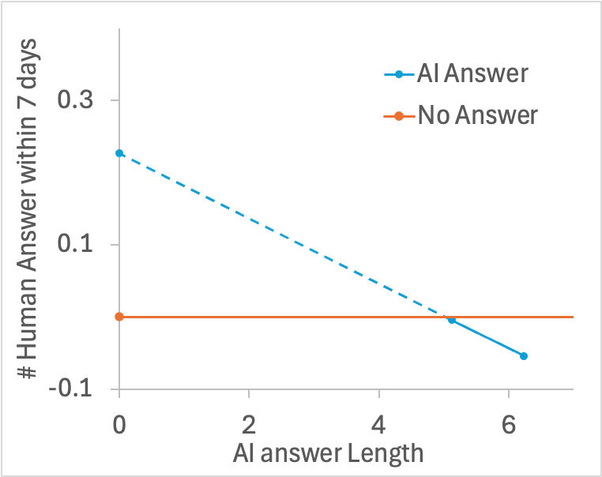
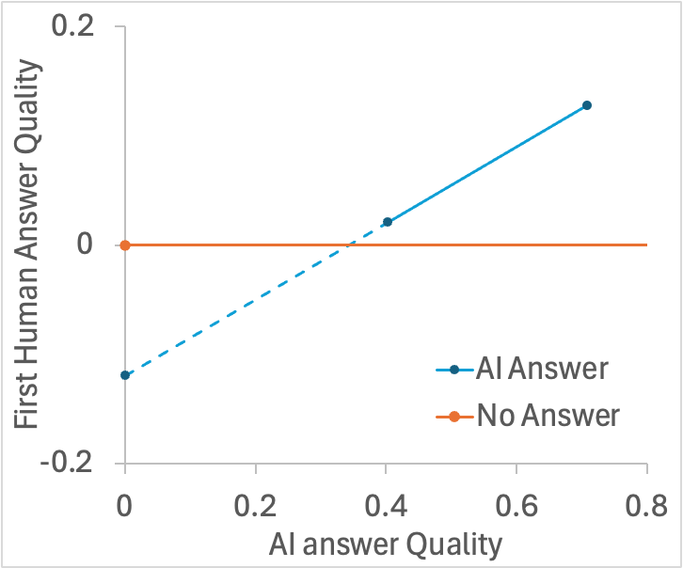
New results
Fast: AI deter human participation when answer is lengthy
Slow: AI elevate human answer quality when answer is high-quality
Notes:
These two plots make the story visual.
Left panel: as AI answer length increases, human contribution drops. The blue line slopes downward. The orange line — control group — is flat. The crossover is around length equals 2 or 3.
Right panel: as AI answer quality increases, human answer quality rises. The blue line slopes upward. Again, the control is flat. When AI quality is low, humans actually do worse. When AI quality is high, humans respond by raising their game.

Slide 14
Reconcile prior findings (Su et. al, 2023)
Su et. al (2023)
AI label encourages participation
Our findings in last round:
AI deters participation
AI label encourages participation; AI content deters participation
Notes:
Now, the reviewers asked: how do you differ from Su et al.? Su et al. found that AI encourages contribution. We found the opposite. This looks like a contradiction.
Our new framework resolves this. Look at the left plot again. The y-intercept of the blue line is above the control line. That's the label effect — positive. Su et al.'s setting likely captures this zone. Their AI answers may be shorter, or their design captures the label effect more cleanly.
Our aggregate effect is negative because our AI answers are long. The content dominates the label.
So the true reason is simple. The label encourages contribution. The content deters it. Both effects are real. Which one dominates depends on how long the AI answer is. Our framework unifies both findings under one logic.

Slide 15
Thank you
Notes:
So to summarize: we replaced a list of isolated mechanisms with one unified framework. Competition with a perceived-weak rival, moderated by dual-process signals. This gives us four clean hypotheses, all supported by the data, and it reconciles our findings with Su et al.
We'd love to hear your thoughts — especially on whether this framing is convincing enough, and whether there are gaps we should address before writing it up.

Slide 16
Appendix

Slide 17
Our new main results
 | (1) | (2) | (3) | (4)
DV | Log(answer number in 7 days) |  | First answer quality (LLM)
AI | -0.046 *** | 0.226 ** | 0.000 | -0.120 #
 | (0.011) | (0.085) | (0.007) | (0.067)
AI * AnswerLength |  | -0.045 ** |  | -0.013
 |  | (0.014) |  | (0.011)
AI * AnswerQuality |  | -0.038 |  | 0.350 ***
 |  | (0.051) |  | (0.034)
question controls | √ | √ | √ | √
questioner controls | √ | √ | √ | √
question timing FE | √ | √ | √ | √
N | 3,613 | 3,603 | 2,685 | 2,685
Notes: # p<0.1, * p<0.05, ** p<0.01, *** p<0.001
Notes:
Now let‘s look at the main results. Four columns here.
Column 1 is our original finding. AI reduces the number of human answers. Negative 0.046, highly significant. This is the same as before — no change.
Column 2 adds the interactions. Look at the AI main effect — it's now positive. 0.226, significant. This means: when AI length is zero — purely hypothetical — the label alone encourages entry. But the interaction with length is negative 0.045, also significant. So as length grows, participation drops. The crossover happens early. At the mean AI length, the net effect is already negative. This is exactly what our theory predicts.
Column 3 is our new DV — first human answer quality. The main effect of AI is zero. No effect on average.
Column 4 adds the quality interaction. The AI main effect is now negative 0.12 — marginally significant. This is the complacency effect from H3. But the interaction with AI quality is positive 0.35 — highly significant. When AI quality is high, human answer quality goes up. H4 is strongly supported.

Slide 18
Competition Effect on Contribution (Fast Processing — Length as Signal)
Has AI Answer
Answerer Participation
AI Answer Length
H1: AI presence increases human contribution. (Competitive Arousal Theory)
The mere presence of AI answer triggers competitive arousal — a heightened motivation to act (Ku et al., 2005)
Human experts perceive AI as a "weak" intruder in their domain → high winning probability → arousal converts into action
This is a fast, label-driven response: seeing "AI" is enough to trigger the impulse to compete
H2: AI answer length attenuates H1. (Competitive Dynamics Theory)
Competitive Dynamics Theory: "If the response will require substantial resource commitment, rivals are less likely to respond and will respond more slowly" (Chen, 1996).
Length is a fast-processed heuristic — humans see a long AI answer without reading it carefully → signals high resource commitment needed to compete → contribution effect attenuated.
Notes:
Slides 16 and 17 have the full theoretical arguments for each hypothesis. I won't read through them now — they're there for reference. But the key logic is what I just walked you through: fast processing drives participation, slow processing drives quality, and the "weak competitor" assumption is the baseline that content signals either reinforce or override.

Slide 19
Competition Effect on Answer Quality (Slow Processing — Quality as Benchmark)
Has AI Answer
Answer Quality
AI Answer Quality
H3: AI presence decreases human answer quality. (Downward Social Comparison Theory)
Downward Social Comparison Theory: comparing with a weaker target is a psychological strategy that substitutes for instrumental action (Wills, 1981).
Humans perceive AI as inferior → downward comparison provides self-enhancement (“I‘m already better”) → replaces actual effort to improve → lower quality.
H4: AI answer quality reverses H3.
Goal Setting Theory: "The highest or most difficult goals produced the highest levels of effort and performance" (Locke & Latham, 2002).
High AI quality can only be assessed through slow, deliberate processing → once recognized, it shatters the "weak competitor" assumption.
A high-quality AI answer serves as a specific, challenging goal to surpass → triggers genuine effort investment → quality rises.
"The AI is actually good — I must prove I'm better."

